Slide 1
Patented Antimicrobial Process for Laundry Operators to Manufacture Sustainable Bioburden Reduced Textiles
U.S. Patent No. 10,844,330, which claims priority under 35 U.S.C. §119(e) to U.S. Patent Application Serial No. 62/295,133
A permanent antimicrobial process to reduce bioburdens 24/7
for 50-continuous washes
Interested in becoming an authorized laundry operator to process-manufacture permanent antimicrobial fabric protection
Visit: www.cleanersolutionsllc.com

Slide 2
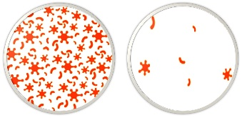
Stay ahead of bioburden with built-in protection
Benefits of Commercial Laundry Operators
Processing permanent antimicrobial fabric protection
Built-In Protection to Protect Textile Investments
Permanent 24/7 antimicrobial protection keeps textiles cleaner, softer & fresher during the 50-Wash Life and between washings by controlling exponential growth of fabric deteriorating, stain & odor causing bacteria & fungi.
Advantage
24/7 antimicrobial protection delivers new revenues for commercial laundry operators or independents. Driving a major competitive advantage to end users. Especially, the high percentage of customers willing to pay more for solutions that offer antimicrobial protection and odor control. Plus, a unique opportunity for hospitals, senior centers, and other healthcare services wanting to expand their cleanliness standards.
Huge cost savings
Ideal for clients maximizing profitability over third-party purchased antimicrobial protected textiles.
Flexibility
Enables the ability to protect any new or previously purchased cotton, synthetic or blended textile. Ranging from clothing, sports apparel, cubical curtains, military-wear, uniforms, medical-wear/scrubs to bedding.

Slide 3
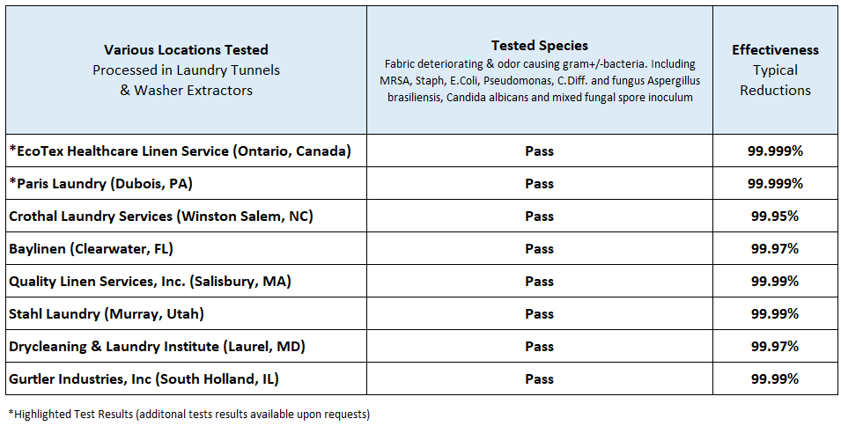
Comprehensive Plant Testing
United States & Canada
Broad-spectrum testing conducted in commercial laundry plants
Antimicrobial Tested
MICROSTATIC I DURABOND

Slide 4
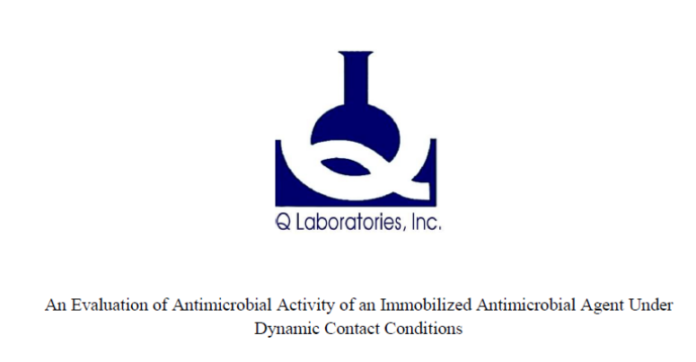
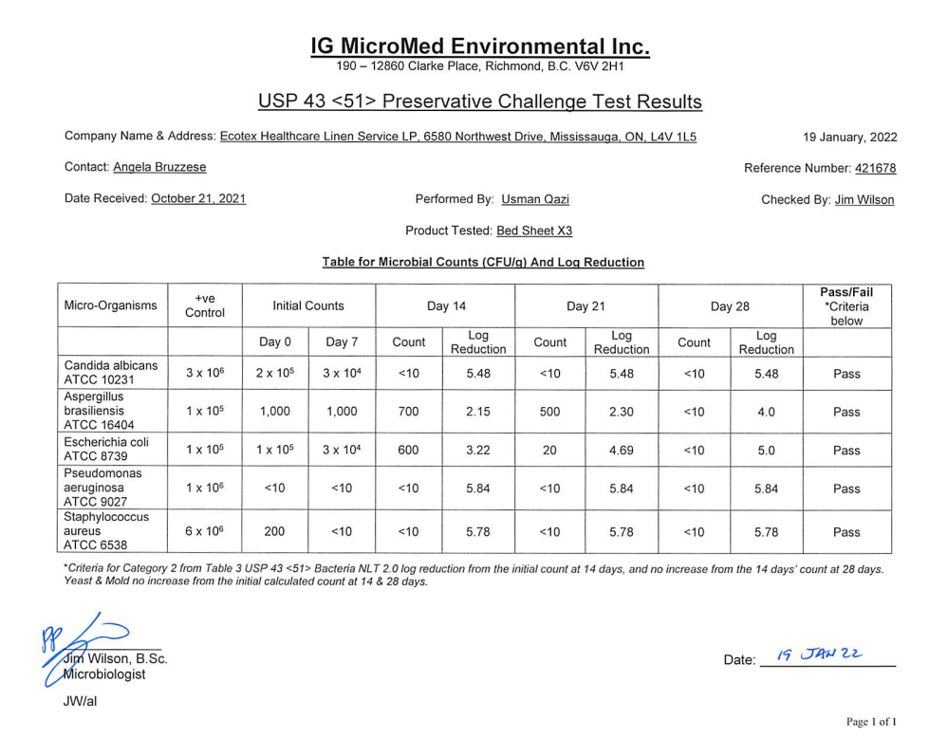
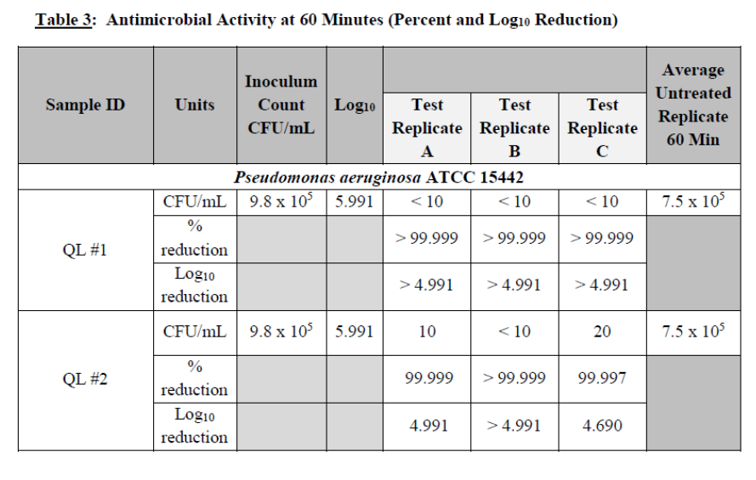
Exceptional Results from Every Plant & Laboratory Tested
Up to 99.999% reduction of bioburdens
Antimicrobial Tested
MICROSTATIC I DURABOND
a non-flammable, water soluble polymer with cross-link technology for superior efficacy & durability

Slide 5
Understanding Cleanliness
Untreated VS Treated Textiles
Treated textiles reduce deteriorating, stain & odor causing bacteria 24/7 up to 50-Washes
What Counts? Establishing a Bioburden Reduction Strategy
Unable to reduce bioburdens and bacteria continue growing
Reduces bioburdens 24/7 between washings

Slide 6
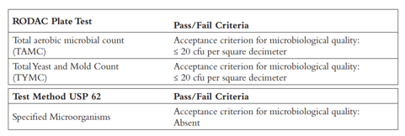
New Standard Raises the bar on in-service cleanliness
CLEAN STANDARD ANTIMICROBIAL STANDARD
Rendered
Hygienically Clean
with any Chemical & Washing Method
Rendered
Hygienically Cleaner
with Sustainable Antimicrobial Protection
START CLEAN STAYS CLEANER & FRESHER Between Washings

Slide 7
Classifies antimicrobials into two categories
EPA Reg.
Number 48937-1
Durabond is not a pesticide and not regulated by DOT. Microstatic active ingredient is registered for formulation into articles as a Mlcrobiostatic agent for material preservation; neither this product nor articles treated with this product may state or imply any public health claims. Articles or substances treated with this product will be exempt from FIFRA regulation Pursuant to 40 CFR 15225 (a) If the Intended use for Incorporating this material into a treated article or substance Is for the protection of the article or substance itself.
Antimicrobial products are divided into two categories Based on the type of microbial pest against which the product works
Category (1) Non-public health products (MICROSTATIC & DURABOND) Used to control growth of microorganisms of economic and aesthetic significance and are not considered to be human health related
Bacteria which cause spoilage, deterioration or fouling of materials and microorganisms infectious only to animals & odor causing bacteria
Category (2) Public health products Intended to control microorganisms infectious to humans in any inanimate environment
viruses
vegetative bacteria
bacterial spores
Antimicrobial pesticide products are categorized as either or "non-public health" or “public health” depending on the specific claims made on each product's labeling. Registrants of public health antimicrobial pesticide products must submit efficacy data to support their application for registration or amendments to add public health claims, whereas registrants of non-public health antimicrobial pesticide products are required to generate efficacy data but not submit those data, unless EPA requests that the data be submitted on a case-by-case basis.
Non-public health antimicrobial pesticide products are those products that bear a label claim to control microorganisms of economic or aesthetic significance, where the presence of the microorganism would not normally lead to infection or disease in humans.
Disclaimer: Wash all garments thoroughly after every use. MICROSTATIC & DURABOND antimicrobial fabric protection does not protect wearers or others against bacteria, viruses or other disease organisms. Wash all fabrics after use. Non-public health products are used to control growth of microorganisms of economic and aesthetic significance and are not considered to be human health related.

Slide 8
Cross-Linked/Covalently Bonded for Antimicrobial Permeance Commercially Laundered up to 50-Washes
MICROSTATIC
COCONUT DERIVED
STOPS BACTERIA
ECOLOGICAL
One time application with nearly 100% pickup rate, provides close to zero discharge of antimicrobials into the environment

Slide 9
SIMPLY DOVETAILS INTO ANY LAUNDRY OPERATION for PERMANENT ANTIMICROBIAL PROTECTION Only 2 minutes in RINSE COMPARTMENT to bond permanent fabric protection (built –in for life)
(2-Minutes)
1-Time Application
MICROSTATIC 18oz
DURABOND 10oz
Patented Antimicrobial Process for Laundry Operators to Manufacture Sustainable Bioburden Reduced Textiles
U.S. Patent No. 10,844,330, which claims priority under 35 U.S.C. §119(e) to U.S. Patent Application Serial No. 62/295,133

Slide 10
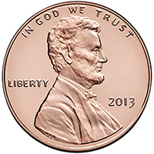
Laundry Manufactured Antimicrobial Protected Textiles for only ½ Penny per lb. based on a 50-wash life
Dose per CWT Sell/gal. Sell/55gal.Drum
MICROSTATIC
Cost per CWT
55Gal Drum
$22.50
18oz
$160.00 $8,800.00 FOB
DURABOND
55Gal Drum
10oz $32.00 $1,760.00 FOB
$2.50
Combined Cost per CWT $25.00
*Maximize savings when processing protection during pre-wash of new fabrics
COST COMPARISON
Laundry Manufactured Antimicrobial Textiles
5% more expensive over untreated textiles
Third-Party Silver/Copper/Etc. Antimicrobial Textiles
150% more expensive over untreated textiles

Slide 11
BIOBURDEN REDUCED LINEN/ANTIMICROBIAL PROTECTED
Previously Impractical & Expensive
There has never been a practical and cost-effective way to produce bioburden reduced linen/antimicrobial protected textiles before now. The PATENTED concept of marrying commercial laundry equipment with an innovative cross-linked, polymer application is unique and makes the production of bioburden reduced linen/antimicrobial protected textiles economically feasible. As demonstrated, the utilization of commercial laundry equipment as a delivery system for the application of permanent antimicrobial technologies, makes the process extremely viable "in mass". By implementing this process, it eliminates the need for softeners and bacstat.
Interested in becoming an authorized laundry operator to process-manufacture permanent antimicrobial fabric protection
Visit: www.cleanersolutionsllc.com

