Slide 1
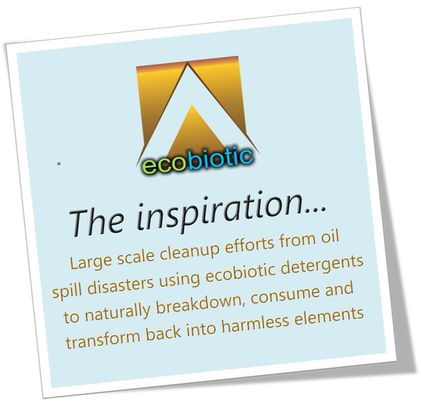

Slide 2
Laundry Detergent Market Analysis I balance hits all marks & beyond
The Laundry Detergents Market size is expected to grow from USD 68.05 billion in 2023 to USD 81.96 billion by 2028
Raising awareness about the importance of cleanliness is expected to drive the studied market. As a result, instead of shifting toward cheaper, private-label household products, (1)consumers' inclination towards well-known, higher-priced detergents was observed, especially amongst the high-income or middle-higher income groups. Moreover, cleaning products including laundry detergent, well-outpaced supply, which means the manufacturers of household staples sold more with fewer deals and discounts.
Additionally, (2)increasing preferences for scented laundry care products and non-allergenic/green products, and the development of new products are gaining consumer acceptance and accelerating the growth of the laundry detergent industry. Owing to this factor, (3) vendors develop laundry care products with unique packaging, fragrance, quality, and price, which enable them to differentiate their products from the competitors. For instance, in March 2021, Kao Corporation, for the first time in Japan, planned to use (4)100% recycled polyethylene terephthalate (PET) plastic for its packaging. It will be used for its new range of Attack ZERO laundry detergent products, and its CuCute Dishwashing Foam Spray bottles. Kao intends to switch over to using 100% recycled PET for household and personal care packaging, using PET bottles by 2025.Additionally, detergent pods are growing in popularity in the premium market because of expanding consumer buying power. (5)The convenience and ease of storage of the products are also driving up demand for pods. (6)Students prefer laundry detergent tablets and bars in particular because of their convenience, conciseness, and portability.
The growing importance of healthier lifestyles with (7)rising concerns among individuals about health and hygienic living, free of germs, bacteria, dust, and dirt has led to rising per capita spending on household cleaning products including laundry detergents. In the past few years, fragrance is playing a vital role in household cleaning products as consumers are increasingly looking for products that offer a strong pleasant odor, which, in turn, makes vendors differentiate their products. In addition, factors such as an increase in household expenditure, and growth in the real estate sector owing to growth in residential units, have increased the demand for laundry detergent products across the globe. Due to increased marketing efforts by industry players, consumers are now more aware of laundry detergent products such as gels, pods, and liquids.
(8) The growth of the liquid and pod laundry detergent markets has been driven by consumers' increasing need for clothes that are simple to clean. When used in a washing machine, liquid laundry detergents provide excellent cleaning while using less energy. They dissolve fast in cold water. Therefore, during the forecast period, all of these advantages are projected to fuel the growth of this segment. For instance, the world's largest laundry care market in 2021 belonged to the United States.
Source: https://www.mordorintelligence.com/industry-reports/laundry-detergents-market

Slide 3
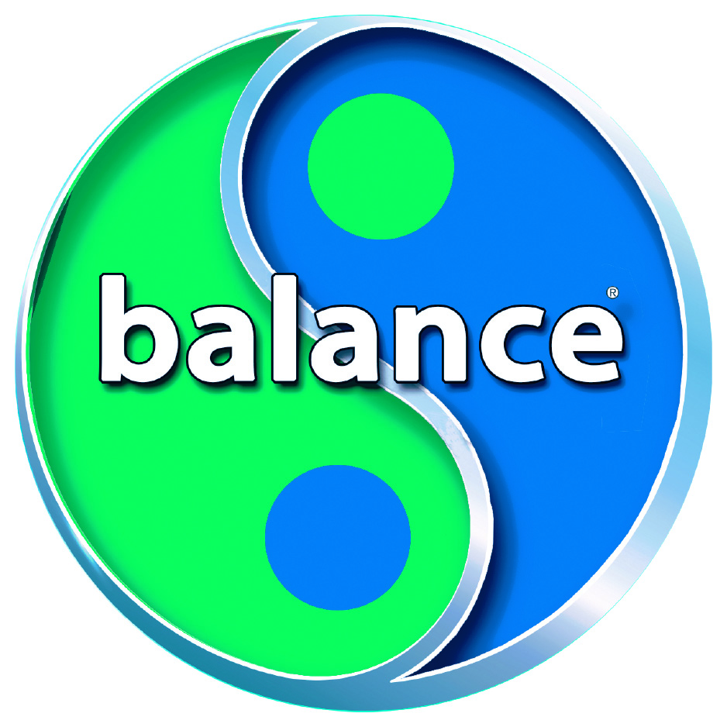
Nothing Else Compares
#1 Laundry Detergent in the World
In every category
Natural Cleaning Actives/Hypoallergenic
Cleans Without a Washing Machine
Performance (commercially rated)
Ecological (highest biodegradability’s)
Improves Water Quality
Stewardship (REACH compliant)
Pure Whiteness
Maintains Fragrance (consumer or commercially processed)
All-Temp Effectiveness
Safety & Handling
Fabric Life & Fiber Protection
Degrees of Softness (reduced skin abrasion)
Natural Freshness
Chemical Savings (no softeners or spot treatments)
Packaging (single-dose sachets/no dermal transfer)

Slide 4
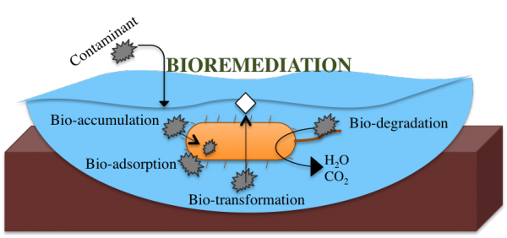
Pure Washing Process
NATURE’S WAY (A NATURAL CLEANING PROCESS)
Highly effective against stains, dirt & grime. Achieved with pure enzyme organisms such as living beneficial-bacteria/ecobiotics to consume & transform dirt & grime. Premediating wastewaters, know as bioremediation, the ability to transform tough organics back into basic elements. Harnessing nature’s way through a natural-process known as self-purification.
Lowers BOD, COD & TSS Levels
Capable of reducing phosphates
Not harmful to aquatic life
Highest biodegradability’s
Microbial bioremediation strategies with wastewater treatment potentialities
The demand for innovative waste treatment techniques has arisen because of the establishment and operation of rigorous waste discharge guidelines into the environment. Due to the rapid increase in the human population, wastewater treatment is a procedure of increasing significance. As a result, wastewater treatment systems are intended to sustain high activities and densities of such microorganisms which meet the different purification requirements. The waste produced by the pharmaceutical industry, if not adequately treated, has harmful repercussions for the environment as well as public health. Bioremediation is an innovative and optimistic technology that can be used to remove and reduce heavy metals from polluted water and contaminated soil. Because of cost-effectiveness and environmental compatibility, bioremediation using microorganisms has an excellent potential for future development. A diverse range of microorganisms, including algae, fungi, yeasts, and bacteria, can function as biologically active methylators, capable of modifying toxic species. Microorganisms play a crucial role in heavy metal bioremediation. Nanotechnology may minimize industry expenses by producing environmentally friendly nanomaterials to alleviate these contaminants. The use of microorganisms in nanoparticle synthesis gives green biotechnology a positive impetus to cost reduction and sustainable production as a developing nanotechnology sector.
Source: Microbial bioremediation strategies with wastewater treatment potentialities – A review - ScienceDirect

Slide 5
Meets & Exceeds
Environmental Standards
REACH Regulation:
REACH stands for Registration, Evaluation, Authorization, and Restriction of Chemicals. It is a comprehensive European Union regulation that governs the production, import, and use of chemicals.
One of REACH’s key objectives is to ensure the safe use of chemicals while protecting human health and the environment.
Substances of Very High Concern (SVHCs):
SVHCs are substances that are particularly hazardous due to their properties (e.g., carcinogenic, mutagenic, toxic to reproduction) or persistence in the environment.
The European Chemicals Agency (ECHA) maintains a Candidate List of SVHCs.
When a substance is added to this list, it triggers legal obligations for companies that manufacture, import, or use the substance.
Candidate List:
The Candidate List includes substances that may be subject to authorization under REACH.
Companies must declare the presence of SVHCs in their products if the concentration exceeds 0.1% weight by weight.
Point of separation, getting REACH Compliant is a difficult and lengthy process
Only representative" established in the EU and appointed by a manufacturer, formulator or article producer established outside the EU to fulfil the registration obligations of importers.

Slide 6
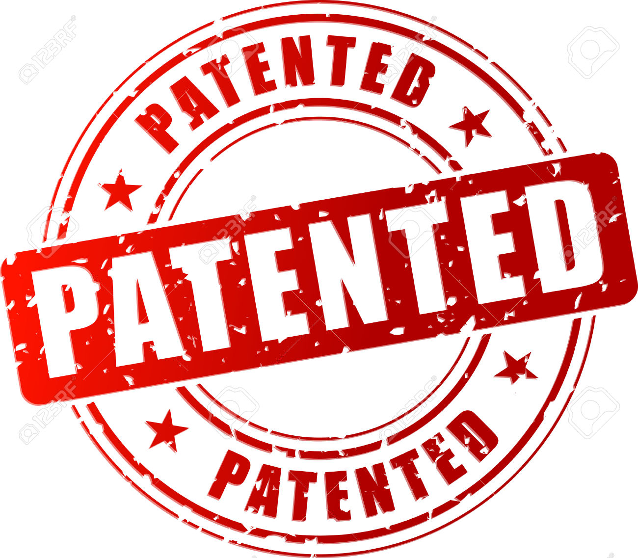
balance detergent PART OF CLEANOVATION Ideal addition to any Eco-Laundry Operation HIGH-SPEED 22 min PROCESSING
CLEANOVATION the innovative system to clean, sanitize, protect & improve our ecology
U.S. Patent No. 10,844,330, which claims priority under 35 U.S.C. §119(e) to U.S. Patent Application Serial No. 62/295,133

Slide 7
balance detergent packaging sizes
1000kg Tote International Only
275gal Tote
55gal Drum
1gal Pail
24 Sachets/Box

Slide 8
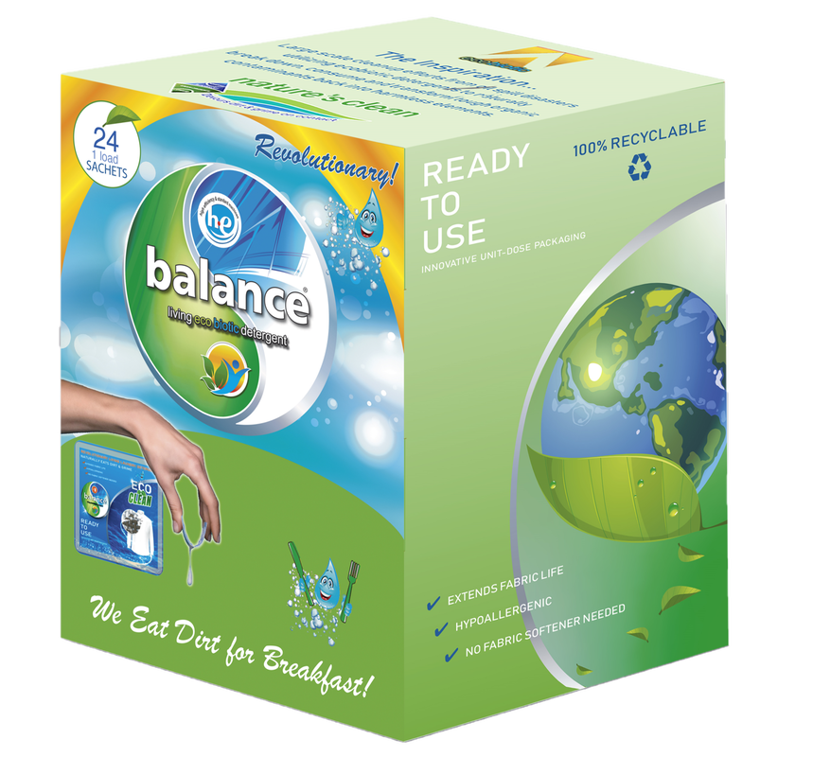
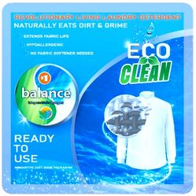
MADE SIMPLE TO CLEAN
SINGLE-DOSE SACHETS
The new way to open using just three fingers, folding the packet in half!
The single-dose sachets that makes life easier
Developed as the easiest way in the world to open a single-portion packet. Before now, it took both hands to open one, with the consequent risk of soiling, spilling the contents and wasting the part that always remains in the packet. Now all that is only a bad memory. Thanks to the use of just three fingers, the packet opens easily and will be ready for use, without any soiling and without having to use scissors or even your teeth as aids to get it completely open.
Environmentally friendly single-portion packaging
Sachets were created entirely for the purpose of using, in addition to the classical materials, recyclable homopolymers and biodegradable materials suitable for compost. In accordance with the principles of the manifesto on the circular economy published by the Ellen Mc Arthur Fundation, the materials are reusable in subsequent production cycles, reducing waste to a minimum and respecting the environment.

Slide 9
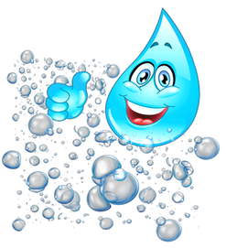
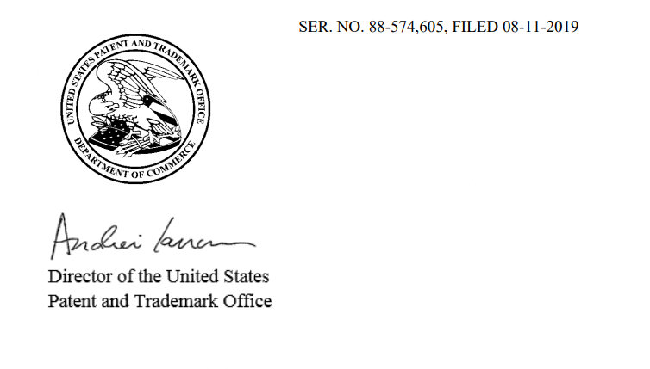
Building the
Naturally, Derived Ambassador
It's hard to see a gecko and not think immediately of the GEICO ads. The little chap with his English accent and charming personality has become a visual representation of everything the insurance company stands for - he's helped to boost its reputation and customer base.
Many brands have earned similar fame from the image or voice of their company mascot or a colorful executive, which proves it's not just how you look but what you say that grabs an audience. Leaders, as well as company symbols, can generate a following through a skillful marketing campaign. They can build familiarity and affection for the brand.
ecobiotic nature's cleaner​
TRADEMARK
Includes a trademark protected, “new adjective” called “ecobiotics” from the founders
ecobiotics, a first to denote beneficial bacteria (microorganisms) designed for the environment to improve water and soil quality, especially those with beneficial properties (such as those that improve the ecology).

Slide 10
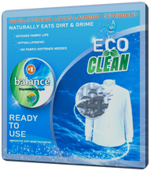
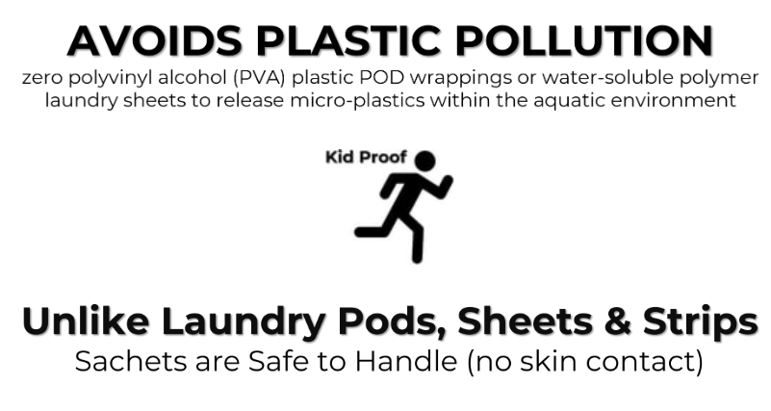
OUR TIME IS NOW
NEW YORK CITY
Published February 19, 2024 10:49am EST
New York City lawmakers move to ban Tide Pods, laundry sheets
A city councilman argues Tide Pods pollute the city's water supply
https://www.foxbusiness.com/lifestyle/new-york-city-lawmakers-move-ban-tide-pods-laundry-sheets?cmpid=FNC_app# (https://www.foxbusiness.com/lifestyle/new-york-city-lawmakers-move-ban-tide-pods-laundry-sheets?cmpid=FNC_app#)
Environmentally friendly single-portion packaging
powerful ​1 LOAD SACHETS

